Slide 1
April 3rd
Alzheimer’s disease:
Characteristics:
-Intracellular and extracellular lesions
-Origin of beta-amyloid peptides

Slide 2
Alzheimer’s disease
Numbers about AD
AD is a PROGRESSIVE IRREVERSIBLE neurodegenerative disease, for which there is no effective treatment yet
Epidemiology
1-AD is the most common form of dementia, accounting for >60% of all the cases.
2-Most of the cases of AD ARE SPORADIC. The prevalence of inherited forms of AD is <0.1%.
3-Risk factors for sporadic AD:
-aging, head injuries, hormonal changes, vascular diseases, inflammation, ApoE e4 allele polymorphism, exposure to metals, like Cu⁺⁺ and Zn⁺⁺
Increased life expectancy, more AD patients
Worldwide:
2001: 24 million. Expected to double in 20 years
2040: 81 million
U.S.:
2011: > 5 million AD patients, 10 million caregivers
U.S. government spends ~ $200 billion/year
Projection for U.S. only 2040:
11.5 million AD patients, 23 million caregivers; > 400 billion/year

Slide 3
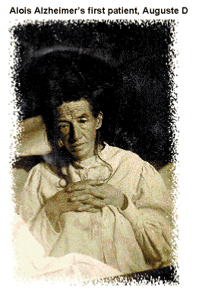
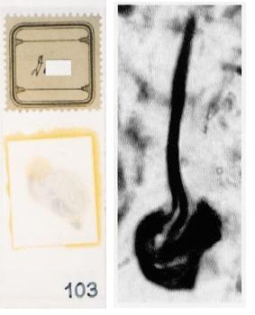
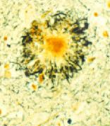
First description of tangle and plaque pathology
by Alois Alzheimer (1901)
A nissl stain tissue section (left) and a Bielkhowsky’s stain section from Augustine Deter’s brain (right)
http://scienceblogs.com/neurophilosophy/Alzheimer

Slide 4
Alzheimer’s disease
AD is a progressive neurodegenerative disorder affecting the elderly population. Once it starts, it progresses with aging.
It is characterized by the presence of lesions both at an extracellular level (the β-amyloid plaques), and at an intracellular levels (the Neurofibrillary tangles, NFT).
The presence of the lesions correlates with both reduction in the volume of the brain (as a consequence of the neurodegenerative phenomena), and with cognitive decline associated to loss of memory.
AD is a form of Dementia.

Slide 5
Definition of Dementia
The loss of intellectual functions (such as thinking, remembering, and reasoning) of sufficient severity to interfere with a person’s daily functioning.
Dementia is not a disease itself but rather a group of symptoms that may accompany certain diseases or conditions. Symptoms may also include changes in personality, mood, and behavior.
Dementia is irreversible when caused by disease or injury but may be reversible when caused by drugs, alcohol, hormone or vitamin imbalances, or depression.

Slide 6
Symptoms in AD
Increasing and persistent forgetfulness
Difficulty performing familiar tasks
Problems with finding the right words to express your thoughts
Disorientation with time and place
Poor or impaired judgment
Problems with abstract thinking
Putting everyday items in illogical places
Mood, behavior or personality changes.

Slide 7
Comparison between AD signs and
age-related memory changes

Slide 8
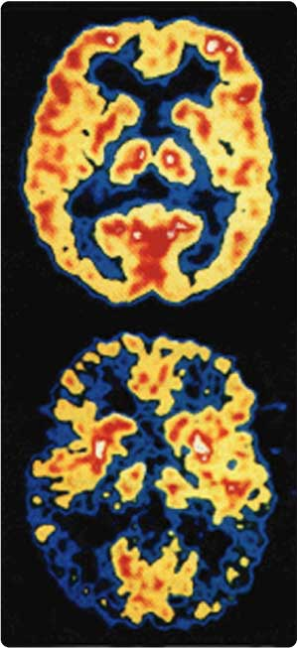
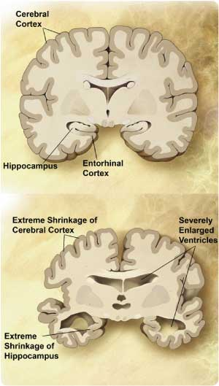
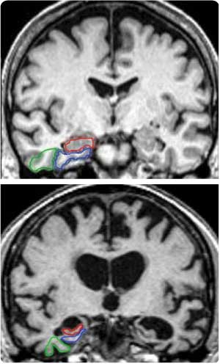
Anatomy of the Alzheimer’s disease brain
PET
MRI
Normal
AD
www.elements4health.com

Slide 9
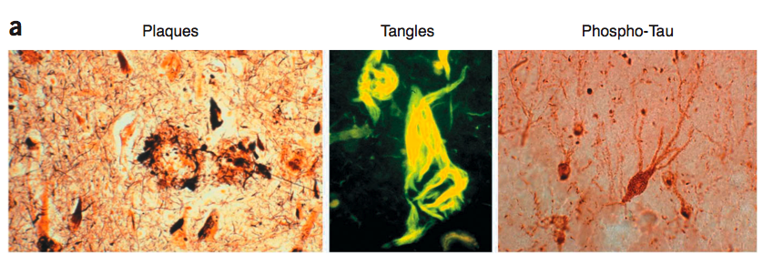
Deposition of fibrillar proteinacious material in Alzheimer’s disease
Alzheimer’s disease: characterized by extracellular depositions, the β-amyloid plaque, and intracellular depositions, the Neurofibrillary Tangles (NFT) comprised of Paired Helical Filaments (PHF), aggregates of hyperphosphorylated protein tau.

Slide 10
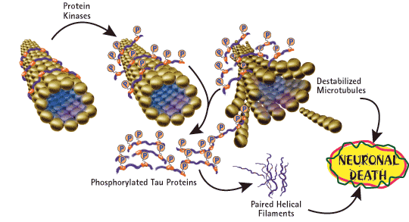
Origin of NFTs and the mechanism of tau pathology
1- Tau is a microtubule-associated protein that regulates cytoskeleton structure.
2- Tau is hyperphosphorylated in AD.
3- When highly phosphorylated, tau is sequestered into aggregates (PHF and NFT) and causes disruption of microtubules, that ultimately leads to cell death.
www.emdbiosciences.com

Slide 11
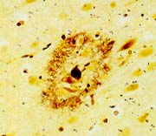
Origin of the β-amyloid plaque
The β-Amyloid Plaque
Aβ oligomers
Aβ
40/42/43
proteolysis
APP
TMD
NH2
COOH
amyloidogenic processing pathway
Mechanisms of Aβ pathology:
Plaque: unknown
Aβ: oligomers affect synaptic activity and neurotransmitter release

Slide 12
The β-amyloid plaque
1- β-amyloid is DIFFERENT from amyloid. β-amyloid contains specifically the β-amyloid peptide, an approximately 4kDa peptide (Aβ40, Aβ42) deriving from APP.
2- The β-amyloid peptide is insoluble in water. When released from the precursor protein it assumes a β-sheet conformation that makes it hydrophobic.
3- β-amyloid peptides forms oligomers are toxic and will further aggregates into fibrils, forming the core of the β-amyloid plaque.
4- The size of the plaque will increase following the progression of the disease.
Cause or consequence or a cause of AD?

Slide 13
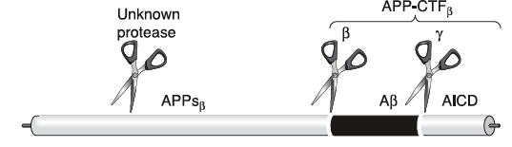
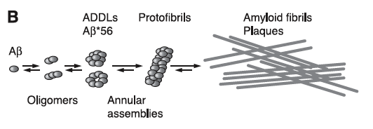
APP processing and formation of aggregates of beta-amyloid

Slide 14
Amyloidogenic processing of APP
β−secretase
γ−secretase
APP
TMD
NH₂
COOH
β−secretase
sβAPP
C99
NH₂
COOH
γ−secretase
Aβ

Slide 15
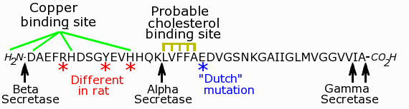
Structure of the β-Amyloid peptide
25-35, the most critical region for the change of conformation from α-helix to β-sheet

Slide 16
Genetic of AD
-Depending on the kind of mutation and on the gene that carries it, the onset of the disease occurs SIGNIFICANTLY EARLIER than in sporadic cases (<before 65 years of age).
All the mutations are autosomal dominant, and involve
*APP protein
*Members of the γ-secretase complex, like Presenilin 1 (PS1) and Presenilin 2 (PS2)

Slide 17
Mutations on APP
Swedish mutation: K670M/N671L, facilitates the amyloidogenic processing of APP by increasing the affinity for and the cleavage by β-secretase of ~100 times.
Dutch Mutation: E693Q, induces cerebral amyloidosis.
Arctic Mutation:E693G enhances β-Amyloid protofibril formation.
London Mutation: V717I, Affects the cleavage of γ-secretase.
K670M/N671L
V717I
London Mutation
E693G
Arctic Mutation
Swedish Mutation

Slide 18
Amyloidogenic processing of APP
!!!β−secretase!!!
!!!γ−secretase!!!
APP
TMD
K670M/N671L
V717I
E693G
NH₂
COOH
β−secretase
sβAPP
C99
NH₂
COOH
γ−secretase
Aβ

Slide 19
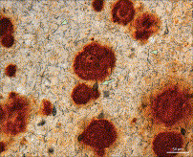
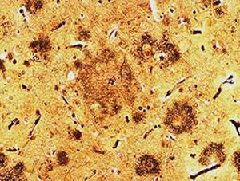
Trisomy of Chromosome 21, Down Syndrome
The higher the levels of APP, the more the Aβ and AD pathology
Aβ positive amyloid plaques
46 y DS
Human AD brain
(Lott and Dierssen, 2010)
http://www.hcplive.com/articles/Alzheimers
-Promoter mutations that increase APP expression are associated with Alzheimer disease (Thenus et al., 2006).

Slide 20
Mutations on Presenilins
PS1 (on chromosome 14) PS2 (on chromosome 1) are ~450 aa long aspartyl proteases comprised of 7- to 8- transmembrane spanning domains. They are the catalytic part of a tetrameric protein complex called γ-secretase, able to cleave APP at the end of the sequence for β-Amyloid peptides, generating β-Amyloid species.
More than 70 mutations on PS1 gene account for inherited AD.
Two mutations on PS2 gene account for inherited AD.

Slide 21
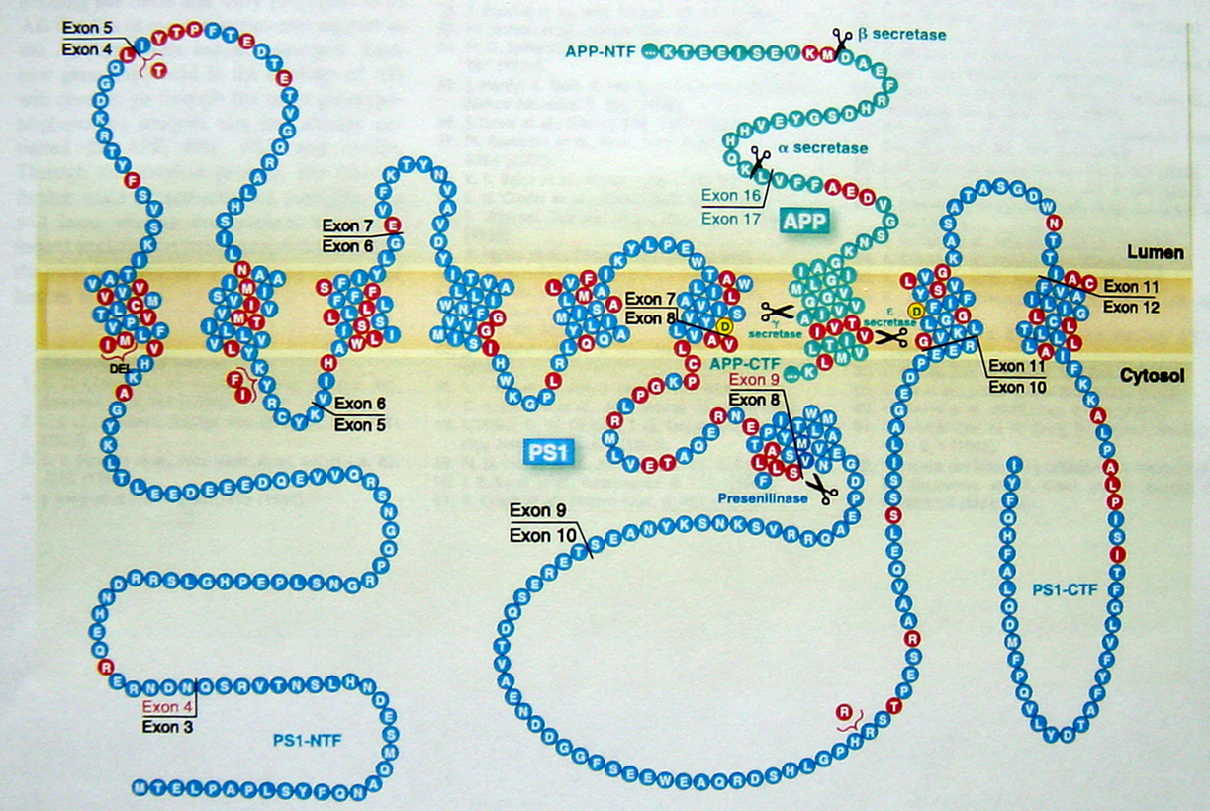
PS1 mutations and APP
Hardy and Selkoe, 2002

Slide 22
Amyloidogenic processing of APP
β−secretase
γ−secretase
APP
TMD
NH₂
COOH
β−secretase
sβAPP
C99
NH₂
COOH
γ−secretase/mutantPS1
Aβ

Slide 23
The β-Amyloid Plaque
Alois Alzheimer: “miliary bodies (the plaques) and dense bundles of fibrils (NFT)”

Slide 24
Characteristic of the β-amyloid plaque
-is extracellular
-normally, it has a core composed of the β-amyloid peptide
-it can be cored (with an intensely stained core with a weak periphery stain-halo) or diffused, which do not have a core and the immunoreactivity is uniform over the plaque.
-aggregation is massive in the center, and diffused at the sides (disaggregation hypothesis?)
-diameter ranges between 20μm and 90μm
-is composed of dystrophic neurites, β-amyloid peptides (40/42/43), ubiquitin, tau protein and other proteins, some involved in the generation of β-amyloid, like the secretases.

Slide 25
Amyloid: definition
Insoluble fibrous protein aggregations sharing specific structural traits:
-Insolubility in water
-β-sheet conformation
-largest aggregates deposit extracellularly
-positive to the staining with specific dyes, such as Congo Red
-associated with tissue degeneration (cause or consequence?)
β-Amyloid
Are formations of amyloid formed by β-amyloid peptides.

Slide 26
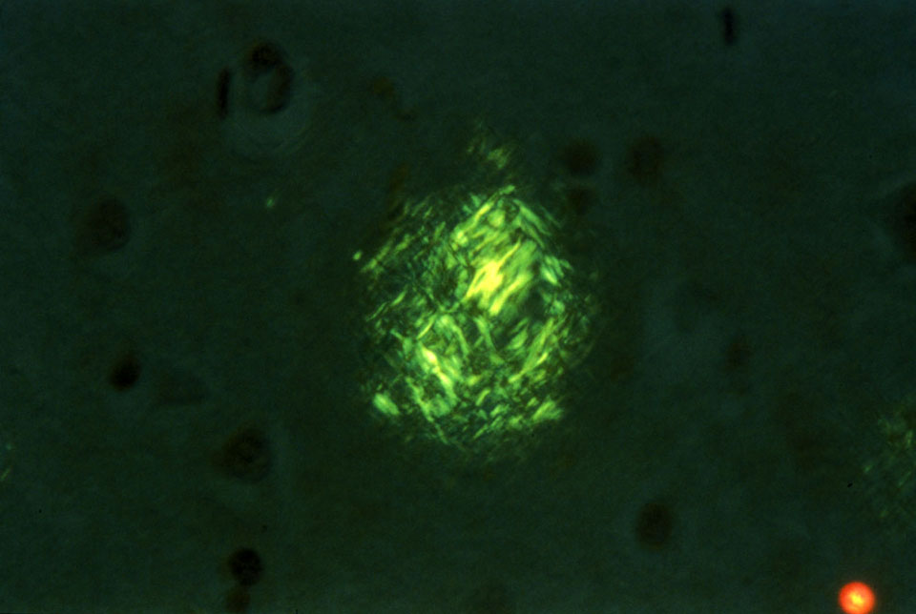
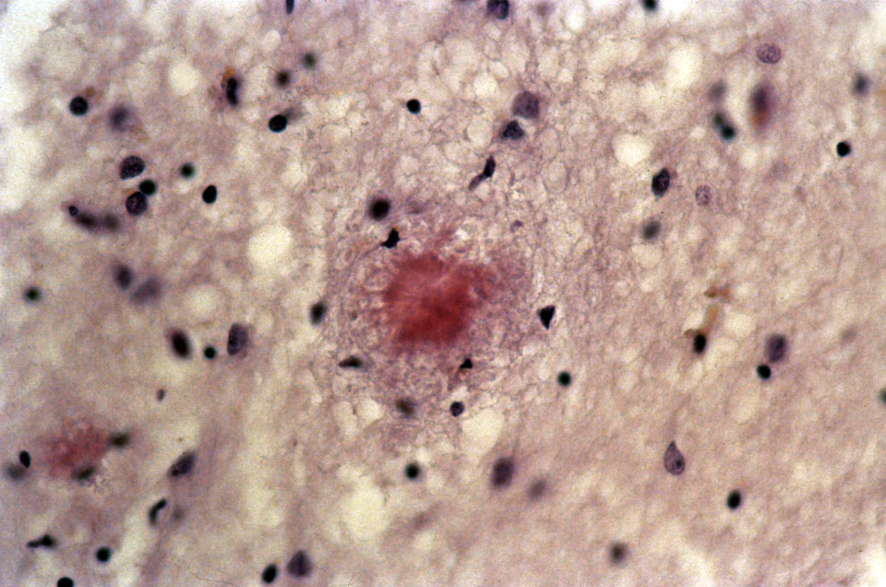
Congo red staining of amyloid plaques
Under polarized light
Under unpolarized light

Slide 27
Can we identify the presence of beta-amyloid plaques for diagnostic purposes?
Pittsburg Compound B versus antibodies specific for β-Amyloid peptides, Aβ 1-40, Aβ 1-42, Aβ 1-43

